Slide 1

Presented by

Slide 2


Slide 5

New iPhone
Retirement
Home Improvements
Wedding
Weekend Getaway
Charity
5 Day Vacation
Engagement Ring
Gifts
Higher Education
Suggested Goal – Save 10% of your net monthly income

Slide 6
456 4,110

Slide 7


Slide 8
Apartment
1 bedroom 1 bathroom 550 square feet
$688
Apartment
2 bedroom 1 bathroom 800 square feet
$830
Mobile Home
3 bedroom 2 bathroom 1500 square feet
$934
Small Single Family
3 bedroom 1.5 bathroom 950 square feet
$1,742
Medium Single Family
3 bedroom 2 bathroom 1750 square feet
$2,079
Large Single Family
4 bedroom 2 bathroom 2500 square feet
$3,075
Includes: Utilities, Insurance, Maintenance, Taxes, and Lawn Care.

Slide 9


Slide 10
Uber / Lyft / Public Transportation – Per Ride | $20
Sedan
Used* | $775
New | $1,002
Minivan
Used* | $787
New | $1,145
Sports Car
Used* | $871
New | $1,173
SUV
Used* | $1,014
New | $1,464
Pickup
Used* | $1,026
New | $1,509
Luxury Car
Used* | $1,050
New | $1,551
Includes: Payment, Insurance, Maintenance, Taxes, Tag, Warranty, and Fuel. *Used car is 5 years old.

Slide 11
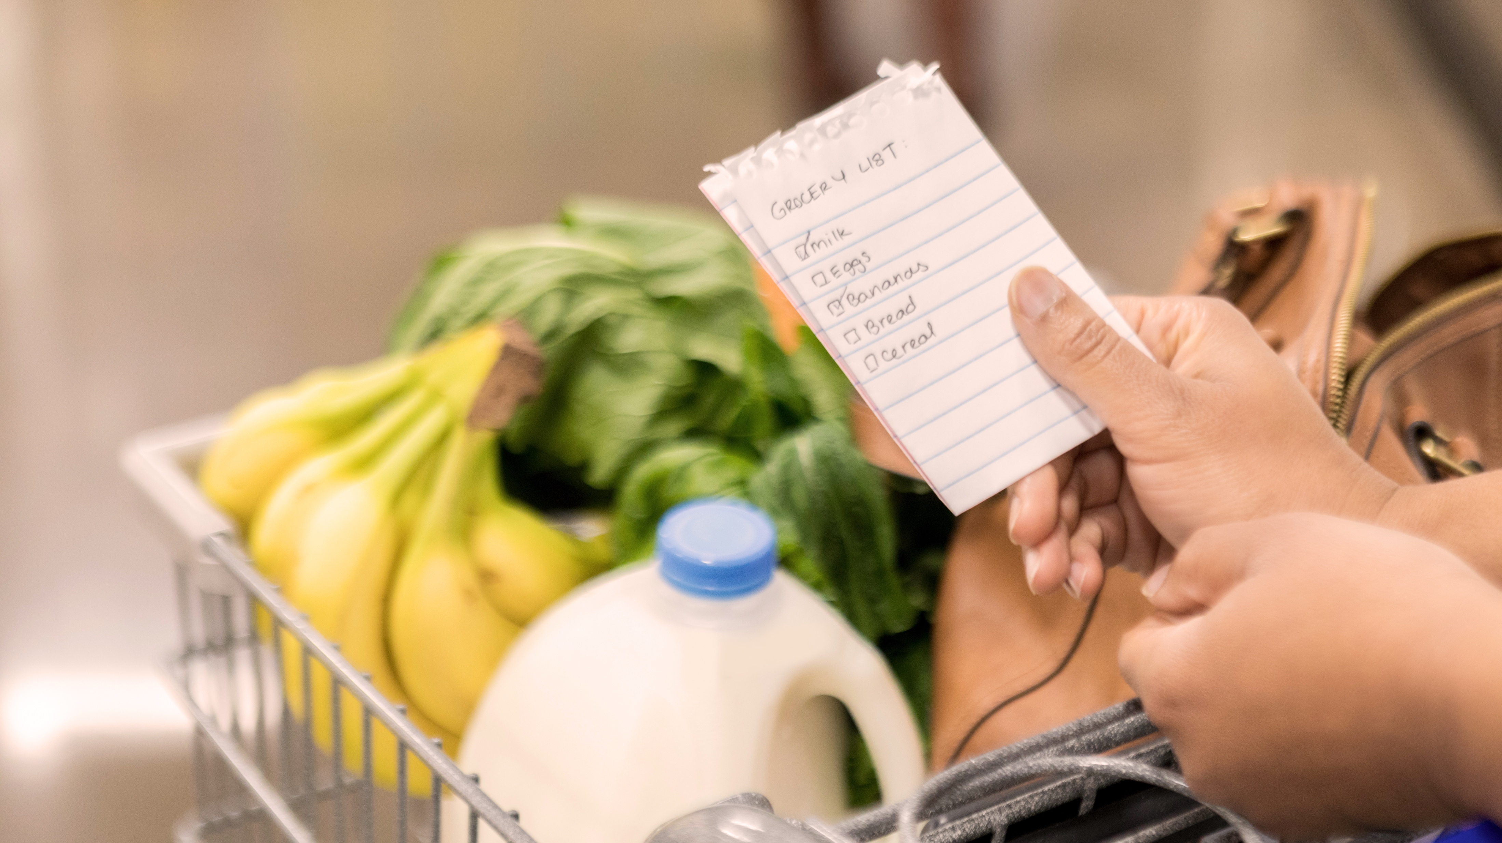

Slide 12
Organic/Non-GMO
Grass Fed Beef Free Range Chicken Organic Dairy Fresh Vegetables Fresh Fruit
$591
Average Groceries
Ground Beef Frozen Pizza Pasta Some Fresh Produce Frozen Vegetables
$443
Budget Groceries
Hamburger Helper Ground Beef Canned Soup Pasta / Rice / Beans Less Fresh Fruits and Vegetables – mostly frozen or canned
$345

Slide 13


Slide 14
Required Costs
Inexpensive Daycare | $519
Formula and Bottles | $104
Diapers and Wipes | $78
Resale Clothing | $11
Resale Toys, Books, etc. | $11
Total | $723
Add-ons
Licensed Daycare | +$50
New Clothes | +$50
New Toys, Books, etc. | +$50

Slide 15
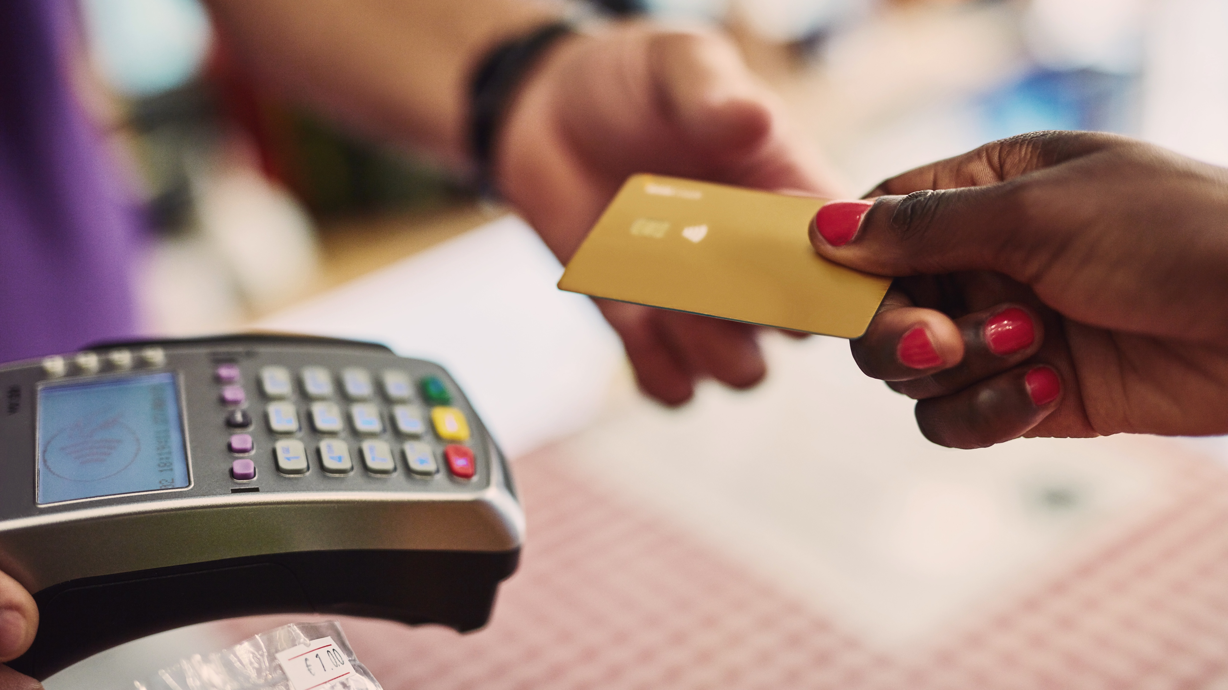

Slide 16
 | Minimum | Minimum + $25 | Minimum + $50 | Minimum + $75
Monthly Payment | $31 | $56 | $81 | $106
Months to it pay off | 30 | 15 | 11 | 8
Interest Paid | $142 | $73 | $50 | $39
Original Debt – $763
Interest Rate – 14%

Slide 17


Slide 18
Fast Food – $9 per visit
Multiply by how many times PER MONTH you eat fast food
Sit Down Restaurant – $25 per visit
Multiply by how many times PER MONTH you eat at a sit down restaurant
Coffee / Tea Shop
Coffee / tea from shop everyday - $90 Coffee / tea from shop every other day - $45 Coffee / tea from shop once a week- $15 Buy supplies and make coffee everyday - $10

Slide 19


Slide 21


Slide 22
Amazon Prime | $10
Apple Music / Spotify | $15
Cable | $85
Cell Phone | $125
Hulu | $8
Internet | $100
Netflix | $11
PlayStation+ | $5
Satellite | $75
Xbox Live | $5

Slide 23


Slide 24
Uniform & Weekend Clothes
Luxury | Bargain
$90 | $65
Business Casual & Weekend Clothes
Luxury | Bargain
$140 | $90
Business Professional & Weekend Clothes
Luxury | Bargain
$300 | $180

Slide 25


Slide 26
Soap / Shampoo
High | $78
Medium | $41
Low | $16
Make-up / Skincare
High | $156
Medium | $78
Low | $36
Shaving Supplies
High | $24
Medium | $21
Low | $10
Women’s Haircut
Every 2 weeks | $83
Every 4 weeks | $41
Every 6 weeks | $28
Every 8 weeks | $21
Men’s Haircut
Every 2 weeks | $41
Every 4 weeks | $21
Every 6 weeks | $13
Every 8 weeks | $10
Gym Membership
Higher End | $50
Bargain | $10

Slide 27


Slide 28
TV
75” | $42
65” | $37
49” | $21
32” | $6
*based on replacing every 5 years
Computer
High | $83
Medium | $42
Low | $21
*based on replacing every 3 years
Furniture
High | $130
Medium | $52
Low | $26
Used | $6
*based on replacing every 10 years
Decorations
High | $52
Medium | $26
Low | $12
Used | $6
Cleaning
Weekly Maid | $700
Monthly Maid | $175
Supplies | $60

Slide 29
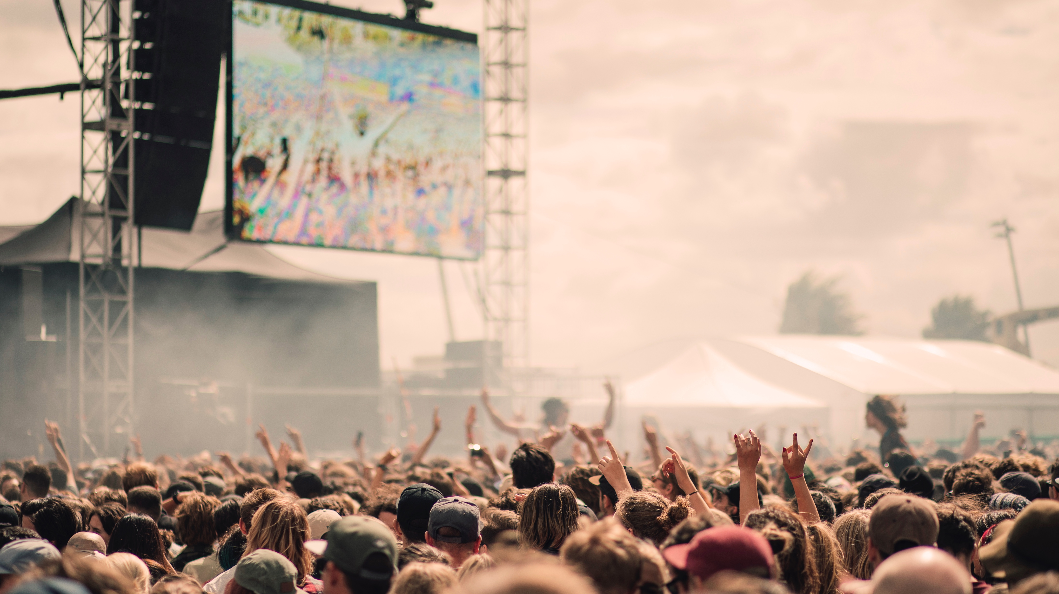

Slide 30
RedBox | $3
High School Game | $11
Hamster | $16
Blu-ray | $21
Video Game | $58
Dog/Cat | $63
Save for Road Trip | $73
Date Night | $78
Throw a Party | $104
Movie Theater | $15/person
Bowling | $30/person
Golf | $60/round
Concert | $75/person
NBA Game | $85/person
College Football Game | $90/person
NFL Game | $125/person

Slide 31
Building rockets?
Making videos?
Debate team?
Cheerleading?
Cooking or Baking?
Playing guitar?
Dancing?
Bike riding?
Rock climbing?
Singing karaoke?
What entertains you?
Activity: |  | Cost: | $
(hobbies, lessons, clubs, crafts, art, music, theater, etc.)

Slide 32

Post-Activity Discussion
Questions?

Slide 33
Presented by
coopteachers.com
© BALANCE 2020

